Slide 1
Template Method Pattern
Behavioral Design Pattern
P-313

Slide 2
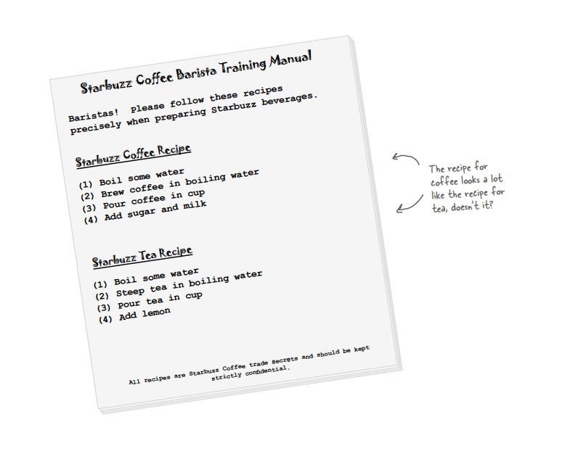

Slide 3
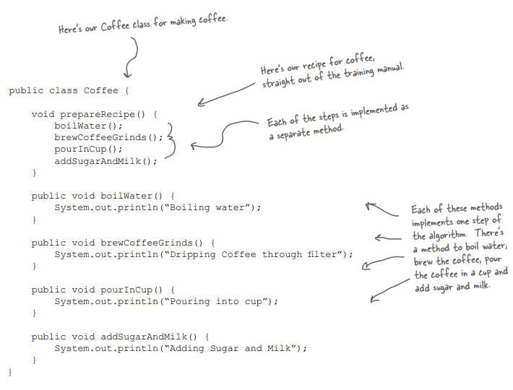
Definition of Coffee Class

Slide 4
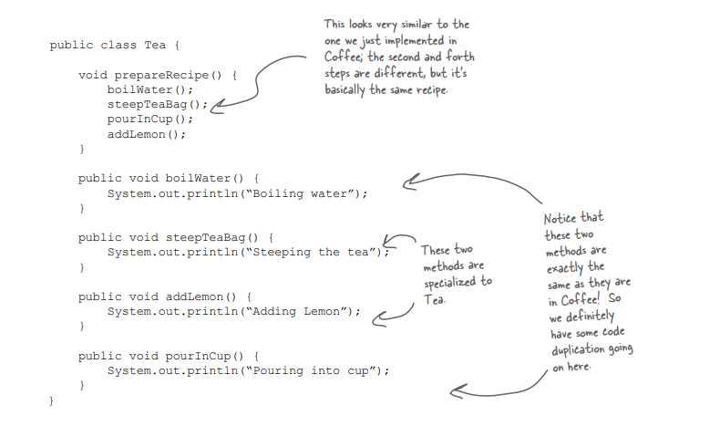
Definition of Tea Class

Slide 5
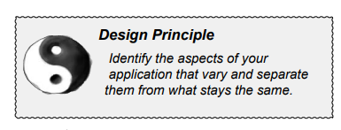
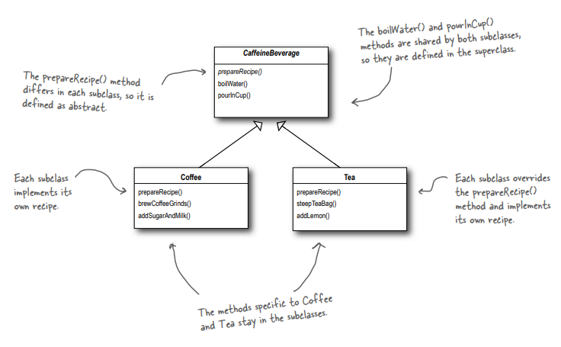
An Abstraction of the problem

Slide 6
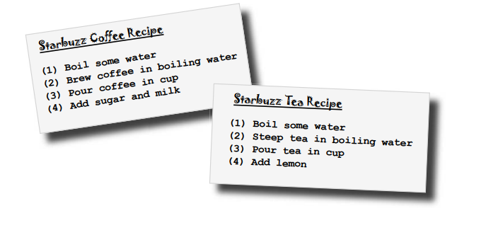
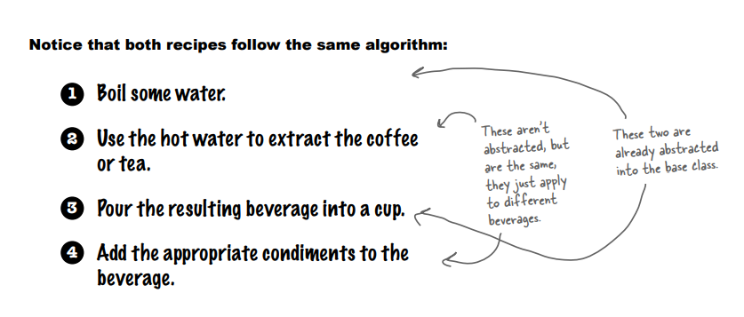
Taking the design further...
Similar but not exactly same
Common

Slide 7
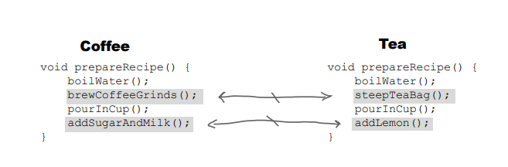
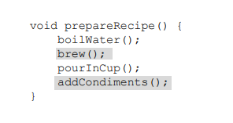
Abstracting prepareRecipe()
Grouping similar type of methods

Slide 8
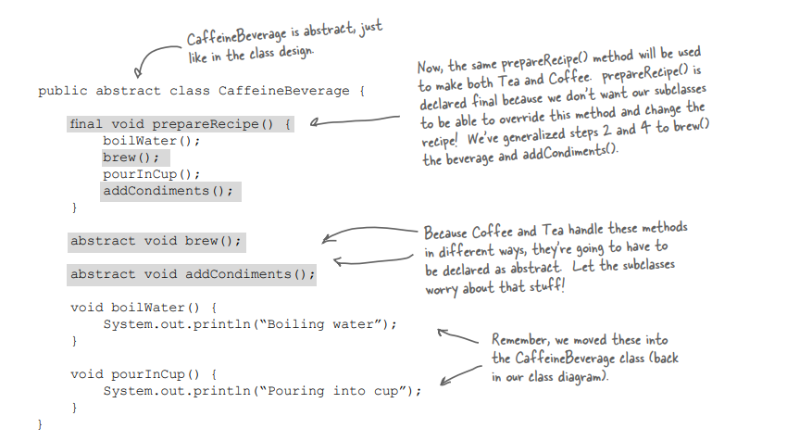
The template Method Pattern
Template method can’t override

Slide 9
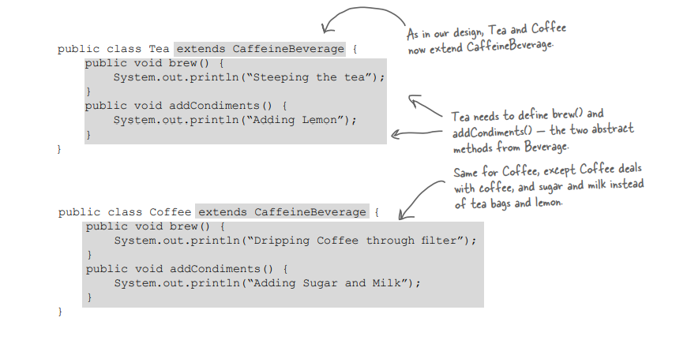
Extension of the abstract classes

Slide 10
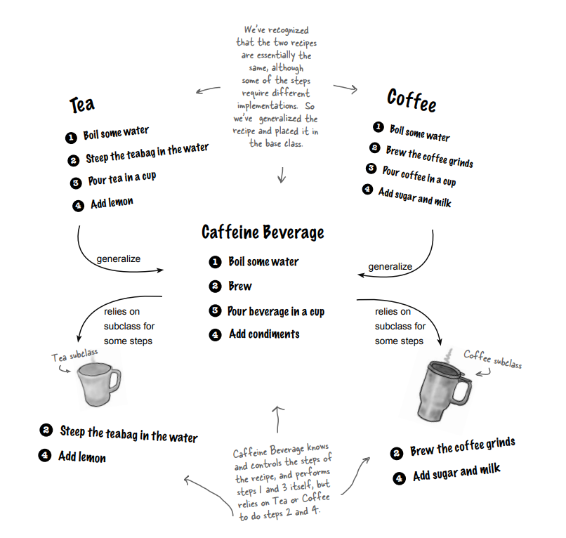
Current status

Slide 11
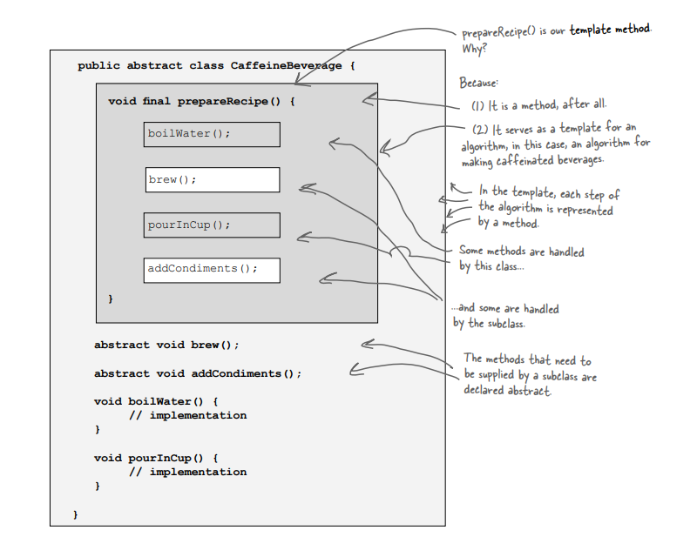
Meet the Template Method
The Template Method defines the steps of an algorithm and allows subclasses to provide the implementation for one or more steps.

Slide 12
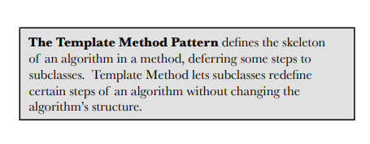
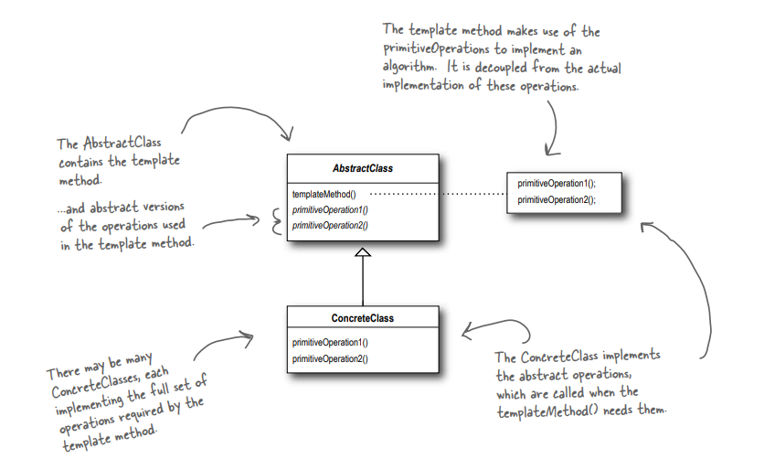
Template Method Pattern defined

Slide 13
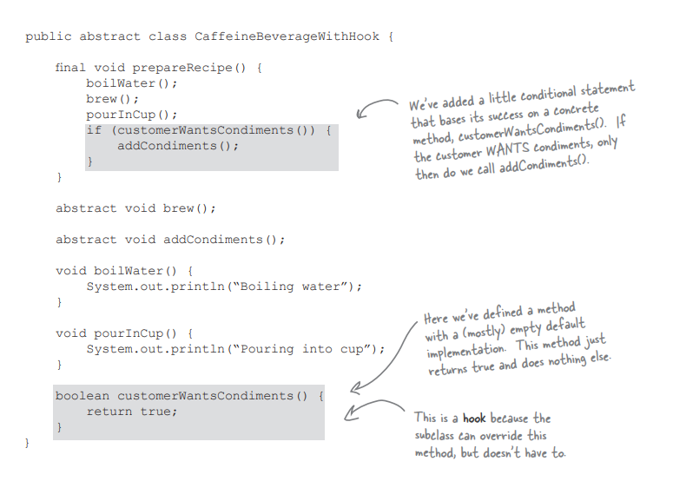
Hooked on Template Method...
Hook

Slide 14
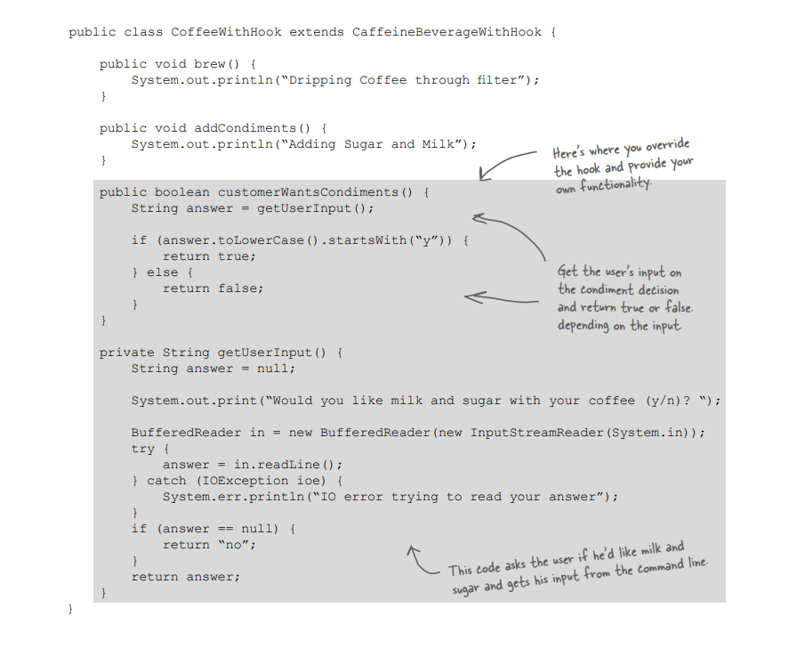
Using the hook
Overridden the hook function

Slide 15
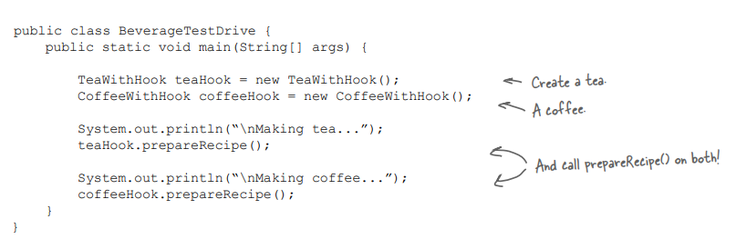
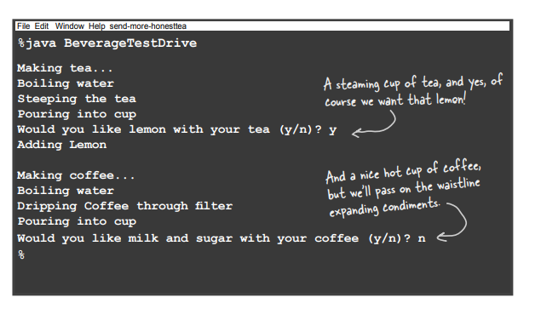
Let’s test the driver code

Slide 16
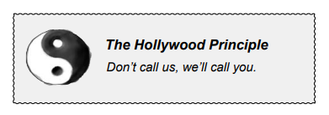
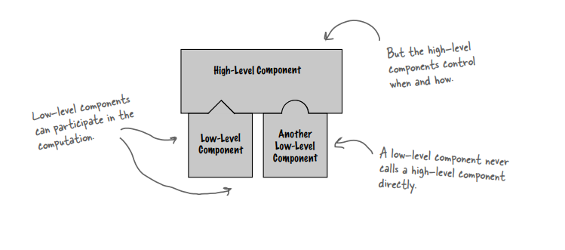
The Hollywood Principle

Slide 17
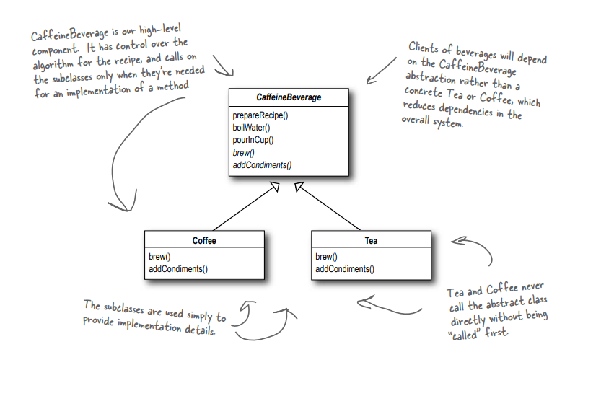
The Hollywood Principle and Template Method

Slide 18
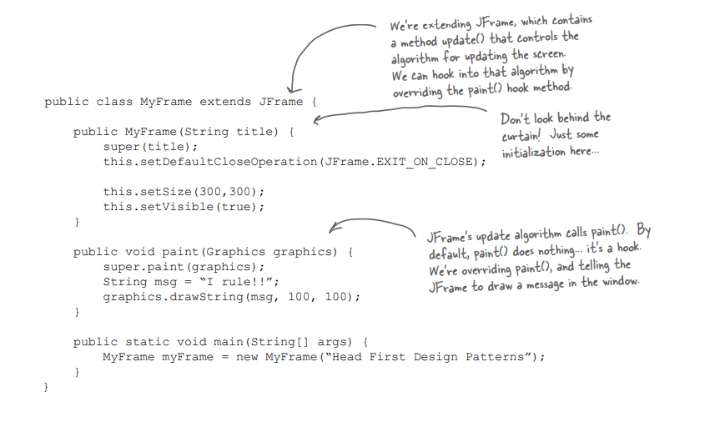
Some additional examples of template method pattern: JFrame

Slide 19
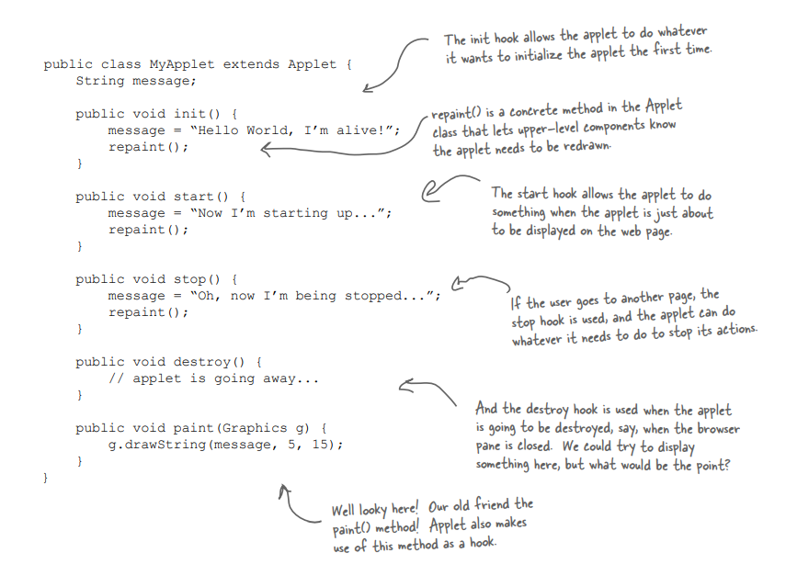
Some additional examples of template method pattern: Applets

Slide 20
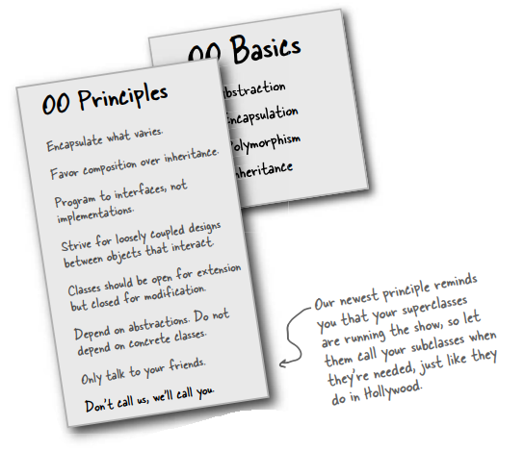
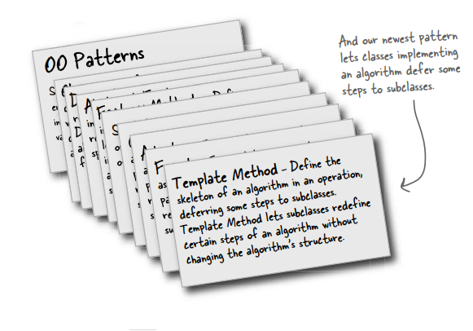
Summary

